Slide 1
Unit-I

Slide 2
Contents
OOP : Introduction of Object-oriented Basic Concepts: Class, Objects, Constructor, Destructor. Methods for updating set...() and retrieving get...() of data members of the class, special methods, Use of self method, _init_ method.
Introduction to Polymorphism and Encapsulation: Operator Overloading, and Function Overloading, Introduction to Encapsulation and Data Hiding.
Inheritance and Abstraction : Modifier and Accessor Methods; Introduction to Inheritance; Single Inheritance; Hierarchical Inheritance; Multiple Inheritance; and Data Abstraction; Abstract Methods and Abstract class, Attribute Resolution Order for Inheritance; Built-in Functions for Classes

Slide 3
Need for OOP
A program is combination of information (data) and set of instructions to manipulate that data
A program is written to perform particular task but software is collection of programs that interoperates to perform one or more tasks
Modern software contains thousand lines of code and operates on terabytes of data, and is complex so more people need to work on it
So we need to organize this instruction so, they will be
Easy to understand and explain
Easy to reuse and extend
Easier to maintain

Slide 4
Introduction to OOP
Object-oriented programming System(OOPs) is a programming paradigm based on the concept of “objects” that contain data and methods.
Object is a logical construct consisting of some user defined data and methods to manipulate that data
Data + operation = object
The primary purpose of object-oriented programming is to increase the flexibility and maintainability of programs.
Object oriented programming brings together data and its behaviour(methods) in a single location(object) makes it easier to understand how a program works.

Slide 5
Object-Oriented Programming or OOPs refers to languages
that use objects in programming.
Object-oriented programming aims to implement real-world entities like inheritance, hiding, polymorphism, etc in programming.
The main aim of OOP is to bind together the data and the functions that operate on them so that no other part of the code can access this data except that function.

Slide 6
OOP Concepts
Class
Objects
Data Abstraction
Encapsulation
Inheritance
Polymorphism
Dynamic Binding
Message Passing

Slide 7
1. Class:
A class is a user-defined data type. It consists of data members and member functions, which can be accessed and used by creating an instance of that class.
It represents the set of properties or methods that are common to all objects of one type. A class is like a blueprint for an object.
For Example: Consider the Class of Cars. There may be many cars with different names and brands but all of them will share some common properties like all of them will have 4 wheels, Speed Limit, Mileage range, etc. So here, Car is the class, and wheels, speed limits, mileage are their properties.

Slide 8
We can think of class as a sketch (prototype) of a house. It contains all the details about the floors, doors, windows etc. Based on these descriptions we build the house. House is the object.
As many houses can be made from a house's blueprint, we can create many objects from a class.
An object is also called an instance of a class and the process of creating this object is called instantiation.

Slide 9
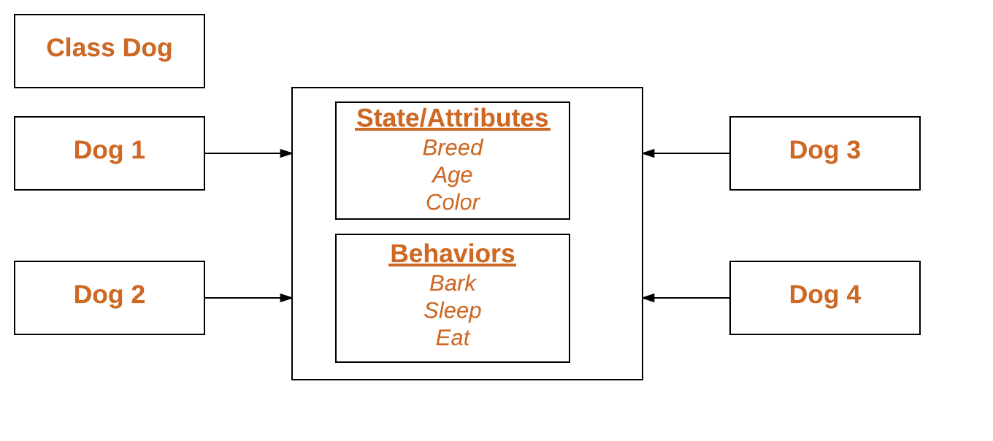

Slide 10
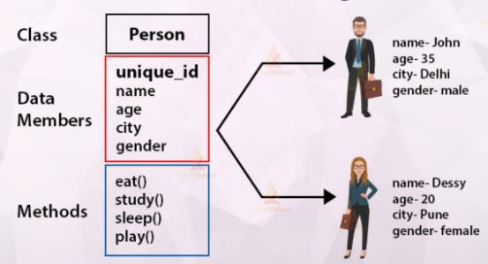

Slide 11
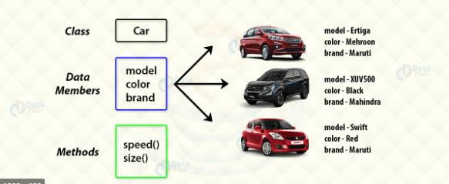

Slide 12
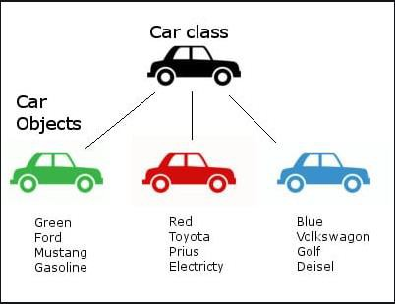

Slide 13
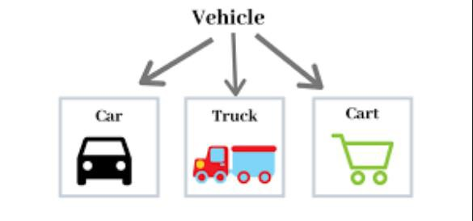

Slide 14
Defining a Class in Python
Class definitions begin with a class keyword.
The first string inside the class is called docstring and has a brief description about the class. Although not mandatory, this is highly recommended.
Syntax:-
class MyNewClass:
'''This is a docstring. I have created a new class'‘’
pass
A class creates a new local namespace where all its attributes are defined. Attributes may be data or functions.

Slide 15
Defining a Class in Python
There are also special attributes in it that begins with double underscores __. For example, __doc__ gives us the docstring of that class.
As soon as we define a class, a new class object is created with the same name. This class object allows us to access the different attributes as well as to instantiate new objects of that class.

Slide 16
2. Object
It is a basic unit of Object-Oriented Programming and
represents the real-life entities.
An Object is an instance of a Class. When a class is defined, no memory is allocated but when it is instantiated (i.e. an object is created) memory is allocated. An object has an identity, state, and behavior.
Each object contains data and code to manipulate the data. Objects can interact without having to know details of each other’s data or code, it is sufficient to know the type of message accepted and type of response returned by the objects.
For example “Dog” is a real-life Object, which has some characteristics like color, Breed, Bark, Sleep, and Eats.

Slide 17
What is Object
Object: is a bundle of data and its behaviour(often known as
methods).
Objects have two characteristics: They have states and behaviors.
Examples of states and behaviors
Example 1:
Object: House
State: Address, Color, Area
Behavior: Open door, close door
So if I had to write a class based on states and behaviours of House. I can do it like this: States can be represented as instance variables and behaviours as methods of the class. We will see how to create classes in the next section of this guide.

Slide 18
Example 2:
Let’s take another example.
Object: Car
State: Color, Brand, Weight, Model
Behavior: Break, Accelerate, Slow Down, Gear change.
Note: As we have seen above, the states and behaviors of an object, can be represented by variables and methods in the class respectively.

Slide 19
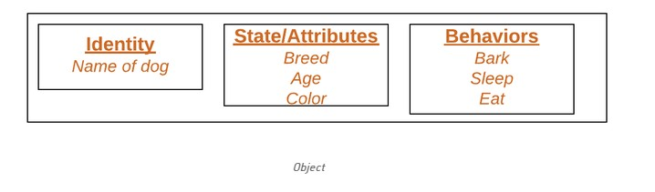

Slide 20
Creating an Object in Python
The procedure to create an object is similar to a function call.
car1 = car() #car is classname, car1 is object name
Syntax:- Object name = class name()
This will create a new object instance named car1. We can access the attributes of objects using the object name prefix.
Attributes may be data or method. Methods of an object are corresponding functions of that class.
car1.color
car1.milage
Objectname.attribute/method

Slide 21
Creating an Object in Python
notice the self parameter in function definition inside the class but we called the method simply as car1.brand() without any arguments. It still worked.
This is because, whenever an object calls its method, the object itself is passed as the first argument. So, car1.brand() translates into car.brand(car1).
In general, calling a method with a list of n arguments is equivalent to calling the corresponding function with an argument list that is created by inserting the method's object before the first argument.
For these reasons, the first argument of the function in class must be the object itself.
This is conventionally called self.

Slide 22

Creating an Object in Python
We saw that the class object could be used to access different
attributes.
It can also be used to create new object instances (instantiation) of that class. The procedure to create an object is similar to a function call.
This will create a new object instance named harry. We can access the attributes of objects using the object name prefix.
Attributes may be data or method. Methods of an object are
corresponding functions of that class.
This means to say, since Person.greet is a function object (attribute of class), Person.greet will be a method object.

Slide 23
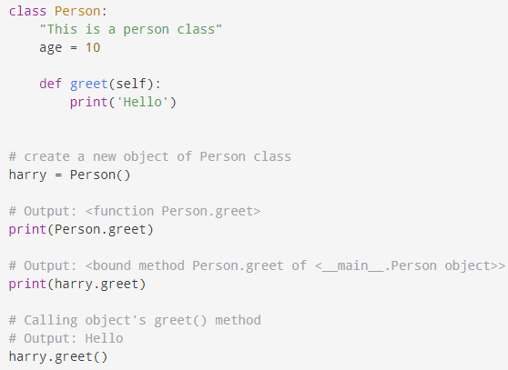

Slide 24
You may have noticed the self parameter in function definition inside the class but we called the method simply as harry.greet() without any arguments. It still worked.
This is because, whenever an object calls its method, the object itself is passed as the first argument. So, harry.greet() translates into Person.greet(harry).
In general, calling a method with a list of n arguments is equivalent to calling the corresponding function with an argument list that is created by inserting the method's object before the first argument.
For these reasons, the first argument of the function in class must be the object itself. This is conventionally called self. It can be named otherwise but we highly recommend to follow the convention.
Now you must be familiar with class object, instance object, function object, method object and their differences.

Slide 25
Object Methods
Objects can also contain methods. Methods in objects are
functions that belong to the object.
Let us create a method in the Person class:

Slide 26
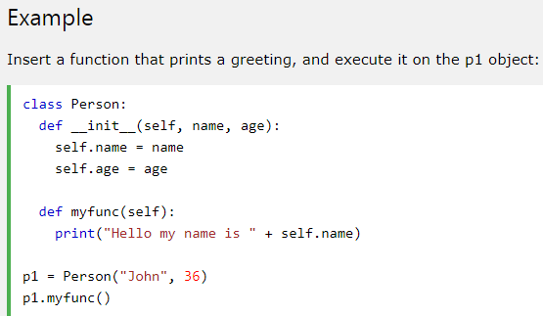

Slide 27
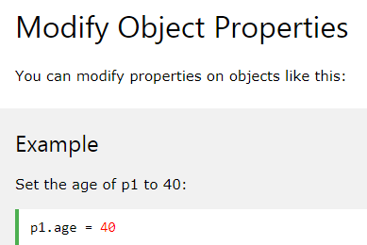

Slide 28
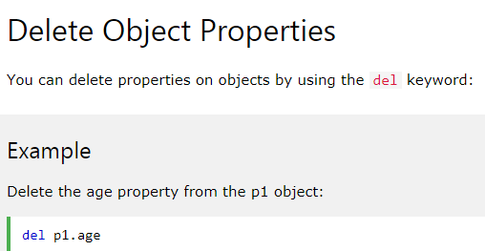

Slide 29
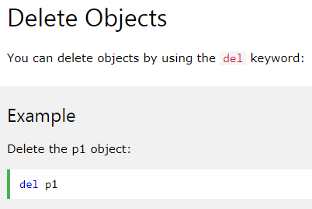

Slide 30
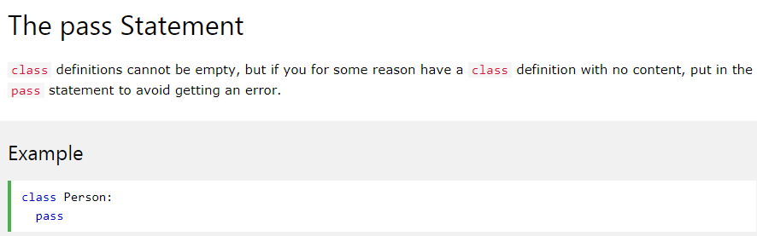

Slide 31
Constructors in Python
A constructor is a special type of method (function) which is used to initialize the instance members of the class.
In C++ or Java, the constructor has the same name as its class, but it treats constructor differently in Python. It is used to create an object.
Class functions that begin with double underscore __ are called special functions as they have special meaning.
Of one particular interest is the __init__() function. This special function gets called whenever a new object of that class is instantiated.
This type of function is also called constructors in Object Oriented Programming (OOP). We normally use it to initialize all the variables
Constructors are generally used for instantiating an object.
The task of constructors is to initialize(assign values) to the data members of the class when an object of class is created.

Slide 32
Creating the constructor in python
In Python, the method the __init__() simulates the constructor of the class.
This method is called when the class is instantiated. It accepts the self-keyword as a first argument which allows accessing the attributes or method of the class.
We can pass any number of arguments at the time of creating the class object, depending upon the __init__() definition.
It is mostly used to initialize the class attributes. Every class must have a constructor, even if it simply relies on the default constructor.

Slide 33
Constructors in Python
Syntax of constructor declaration :
def __init__(self):
# body of the constructor
Example:-
class Employee:
def __init__(self, name, id):
self.id = id
self.name = name

Slide 34
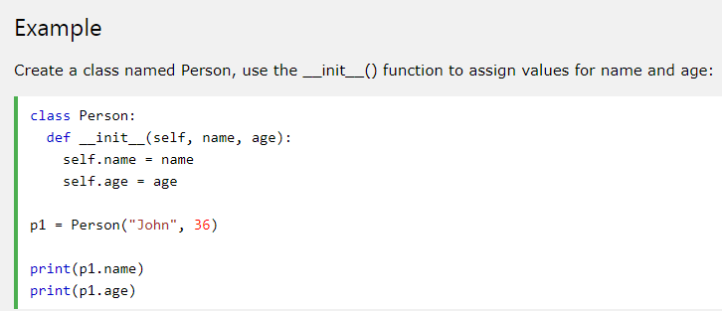

Slide 35

Constructor
Constructors are generally used for instantiating an object. The task of constructors is to initialize(assign values) to the data members of the class when an object of class is created. In Python the __init () method is called the constructor and is always called when an object is created.
Syntax of constructor declaration :

Slide 36
Types of constructors :
1. Default constructor
constructor which
:The
doesn’t
default constructor is simple
accept any arguments. It’s
definition has only one argument which is a reference to the instance being constructed.
2. Parameterized constructor :constructor with parameters is known as parameterized constructor. The parameterized constructor take its first argument as a reference to the instance being constructed known as self and the rest of the arguments are provided by the programmer.

Slide 37
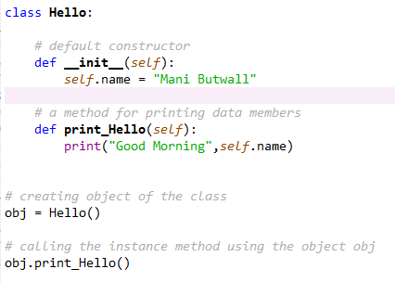

Slide 38
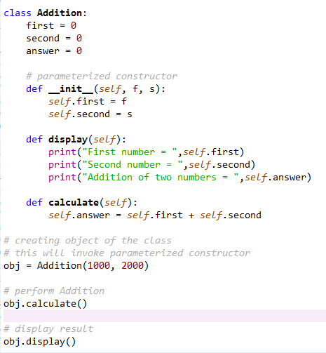

Slide 39
An object cannot be created if we don’t have a constructor in our program. This is why when we do not declare a constructor in our program, python does it for us.
For Example:-
class DemoClass:
num = 101
# a method
def read_number(self):
print(self.num)
# creating object of the class
obj = DemoClass()
# calling the instance method using the object obj
obj.read_number()

Slide 40
In this example, we do not have a constructor but still we are able to create an object for the class.
This is because there is a default constructor implicitly injected by python during program compilation
this is an empty default constructor that looks like this:
def __init__(self): # no body, does nothing.

Slide 41
class DemoClass:
num = 101
# non-parameterized constructor
def __init__(self):
self.num = 999
# a method
def read_number(self):
print(self.num)
# creating object of the class
obj = DemoClass()
# calling the instance method using the object obj
obj.read_number()

Slide 42
Class Variables
Class variables are defined within the class construction. Because they are owned by the class itself, class variables are shared by all instances of the class.
They therefore will generally have the same value for every instance unless you are using the class variable to initialize a variable.
Defined outside of all the methods, class variables are, by convention, typically placed right below the class header and before the constructor method and other methods.
Just like with any other variable, class variables can consist of any data type available to us in Python.
Class variables allow us to define variables upon constructing the class. These variables and their associated values are then accessible to each instance of the class.

Slide 43
Example:-
class Shark:
animal_type = "fish"
location = "ocean"
followers = 5
new_shark = Shark()
print(new_shark.animal_type)
print(new_shark.location)
print(new_shark.followers)

Slide 44
Instance Variables
Instance variables are owned by instances of the class.
This means that for each object or instance of a class, the instance variables are different.
Unlike class variables, instance variables are defined within methods.
Instance variables, owned by objects of the class, allow for each object or instance to have different values assigned to those variables.

Slide 45
class Shark:
def __init__(self, name, age):
self.name = name
self.age = age
new_shark = Shark("Sammy", 5)
print(new_shark.name)
print(new_shark.age)

Slide 46

Destructor
Destructors are called when an object gets destroyed.
In Python, destructors are not needed as much needed in C++ because Python has a garbage collector that handles memory management automatically.
The del () method is a known as a destructor method in Python.
It is called when all references to the object have been deleted i.e when an object is garbage collected.
Note : A reference to objects is also deleted when the object goes out of reference or when the program ends.
Syntax:

Slide 47
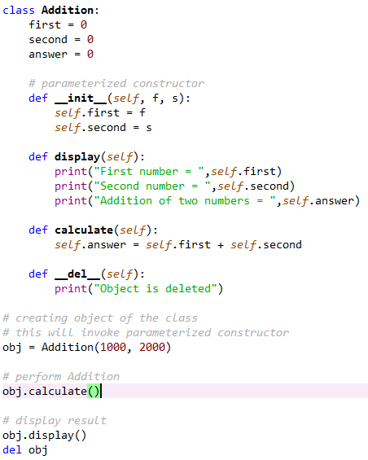

Slide 48
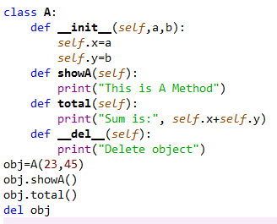

Slide 49
Inheritance
The method of inheriting the properties of parent class into a child class is known as inheritance. It is an OOP concept. Following are the benefits of inheritance.
Code reusability- we do not have to write the same code again and again, we can just inherit the properties we need in a child class.
It represents a real world relationship between parent class
and child class.
It is transitive in nature. If a child class inherits properties from a parent class, then all other sub-classes of the child class will also inherit the properties of the parent class.

Slide 50
In python inheritance, new class/es inherits from older class/es.
The new class/es copy all functions and attributes of the older class into itself without rewriting the syntax in the new class/es.
These new classes are also called derived classes, and old classes are called base classes.

Slide 51
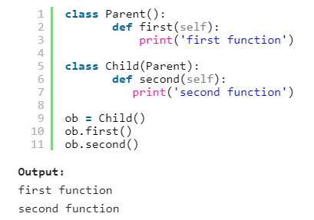

Slide 52
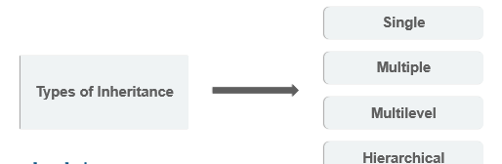
Types Of Inheritance
Depending upon the number of child and parent classes
involved, there are four types of inheritance in python.
•

Slide 53
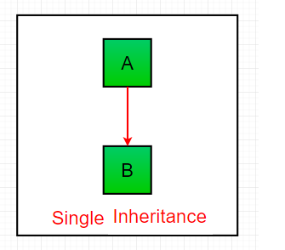
Single Inheritance in Python
Single Inheritance is the simplest form of inheritance where a single child class is derived from a single parent class. Due to its candid nature, it is also known as simple inheritance.

Slide 54
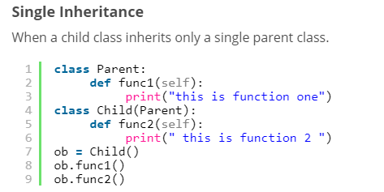

Slide 55
Multiple Inheritance in Python
In multiple inheritance, a single child class is inherited from two or more parent classes.
This means the child class has access to all the methods and attributes of all the parent classes.
However, if two parents have the same “named” methods, the child class performs the method of the first parent in order of reference.
To get a better understanding of which class’s methods shall be executed first, same “named” methods, the child class performs the method we can use the Method Resolution Order function (mro). This tells the order in which the child class is interpreted to visit the other classes.

Slide 56
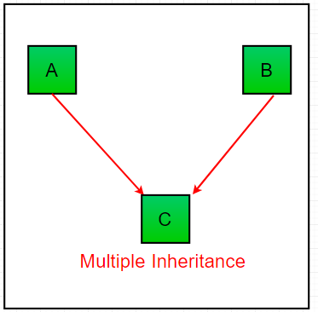

Slide 57
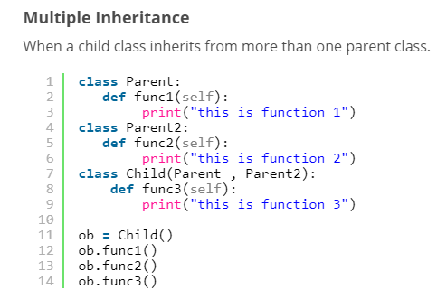

Slide 58
Multi-Level Inheritance in Python
In multilevel inheritance, we go beyond just a parent-child relation.
We introduce grandchildren, great-grandchildren, grandparents, etc.
Basically, till now we saw only two levels of inheritance with a superior parent class/es and a derived class/es, but here we can have multiple levels where the parent class/es itself is derived from another class/es.

Slide 59
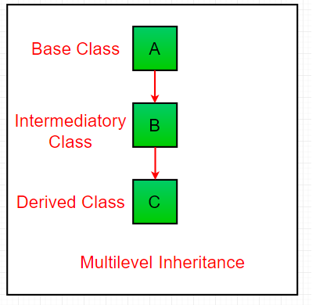

Slide 60
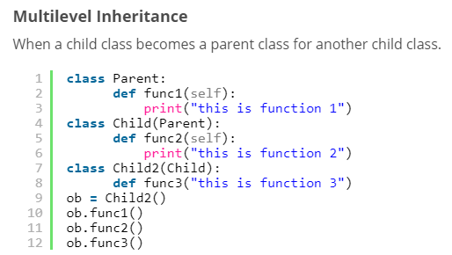

Slide 61
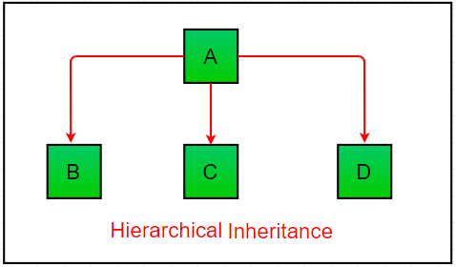
Hierarchical Inheritance in Python
Hierarchical Inheritance is the right opposite of multiple inheritance.
This means that there are multiple derived child classes from a single parent class.

Slide 62
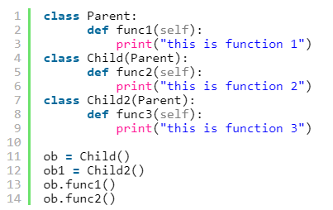
Hierarchical Inheritance
Hierarchical inheritance involves multiple inheritance from the
same base or parent class.

Slide 63
Hybrid Inheritance in Python
Hybrid Inheritance is the mixture of two or more different types of inheritance.
Here we can have many to many relations between parent classes and child classes with multiple levels.

Slide 64
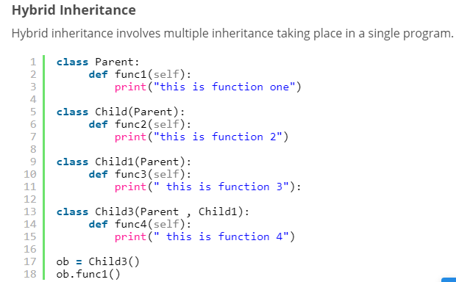

Slide 65
Method Resolution Order in Python
Method resolution order describes the search path of the class which Python uses to get the appropriate method in classes that contain the multi-inheritance.
As we know that, a class that being inherited is called the Subclass or Parent class, while the class that inherits is known as a child class or subclass.
In the multi-inheritance, a class can consist of many functions, so the method resolution order technique is used to search the order in which the base class is executed.
In simple words - "The method or attributes is explored in the current class, if the method is not present in the current class, the search moves to the parent classes, and so on". This is an example of a depth-first search.

Slide 66
When we search for an attribute in a class that is involved in python multiple inheritance, an order is followed.
First, it is searched in the current class. If not found, the search moves to parent classes. This is left-to-right, depth-first.
This order is called linearization of class Child, and the set of rules applied are called MRO (Method Resolution Order).
To get the MRO of a class, you can use either the __mro__ attribute or the mro() method.

Slide 67
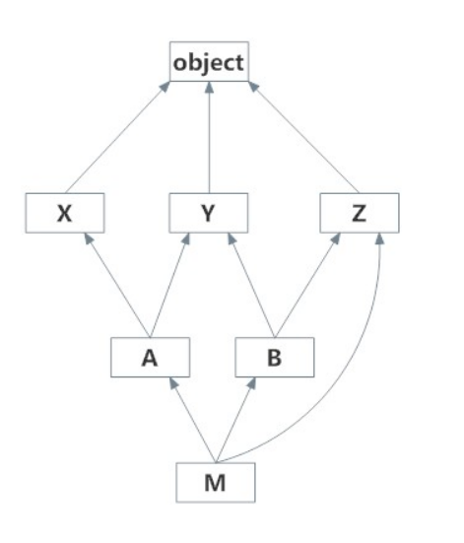

Slide 68
It plays an essential role in multiple inheritance where the same method can be found in the multiple super classes.
class A:
def myname(self):
print("I am a class A")
class B(A):
def myname(self):
print("I am a class B")
class C(A):
def myname(self):
print("I am a class C")
c = C()
print(c.myname())

Slide 69
There is a multiple inheritance in the above code.
We have defined three-class called A, B, and C, and these classes have the same name method called myname().
We created an object of class C. The object invoked class C, not the class, while class C inherited the class A method.
The order is followed in the above code is class B - > class A. This technique is known as MRO (method resolution order)

Slide 70
Special Functions in Python Inheritance
Python is a very versatile and user-friendly language.
It provides some amazing in-built functions which makes our lives easier when it comes to understanding inheritance especially of a complex nature.
super() function
Method overriding is an ability of any object-oriented programming language that allows a subclass or child class to provide a specific implementation of a method that is already provided by one of its super-classes or parent classes.
This discrepancy is caused due to similar naming convention of the methods.
Commonly we can see this situation when the parent’s init() is overridden by the child’s init() and hence the child class is unable to inherit attributes from the parent class.

Slide 71
Similarly, we can face this same problem with methods other than init but having the same naming convention across parent and child classes.
One way to solve this, is to call the parent method inside the child method.

Slide 72
The super function in Python is used to access methods of the immediate parent class.
Syntax:-
class ClassName(ParentClass):
def method(self, arg):
super([ClassName], [self]).method(arg)
Parameters of super() in Python
The super function in Python takes two optional parameters:
ClassName: This is the name of the subclass.
ClassObject: This is an object of the subclass.
Return Type: <class 'super'>
The super in Python returns a temporary proxy object of the immediate parent class that can be used to call methods of the parent class.

Slide 73
# python 3 syntax
# solution to method overriding - 1
class parent: # parent class
def __init__(self): # __init__() of parent
attr1 = 50
attr2 = 66
class child(parent): # child class
def __init__(self): # __init__() of child
parent.__init__(self) # calling parent’s __init__()
#super().__init__()
attr3 = 45
test = child() # object initiated
print (test.attr1) # parent attribute called via child

Slide 74
Another way to solve this problem without explicitly typing out the parent name is to use super().
It automatically references the parent/base class the child class is derived from.
This is extremely helpful to call overridden methods in classes with a huge number of methods.
Here, the first parameter references the child class / subclass the function is used in.

Slide 75
# python 3 syntax
# solution to method overriding - 2
class parent: # parent class
def display(self): # display() of parent
print(“Hello Parent”)
class child(parent): # child class
def display(self): # display() of child
super().display() # referencing parent via super()
print(“Hello Child”)
test = child() # object initiated
test.display() # display of both activated

Slide 76
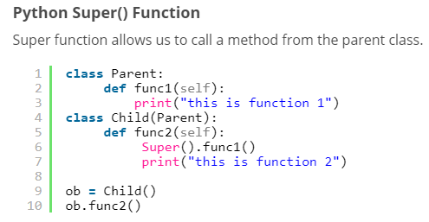

Slide 77
issubclass() function
issubclass()
The issubclass() function is a convenient way to check whether a class is the child of the parent class.
In other words, it checks if the first class is derived from the second class. If the classes share a parent-child relationship, it returns a boolean value of True. Otherwise, False.

Slide 78
Syntax: issubclass(object, classinfo)
Parameters: Object: class to be checked classinfo: class, types or a tuple of classes and types
Return Type: True if object is subclass of a class, or any element of the tuple, otherwise False.

Slide 79
class Vehicles:
def __init__(vehicleType):
print('Vehicles is a ', vehicleType)
class Car(Vehicles):
def __init__(self):
Vehicles.__init__('Car')
print(issubclass(Car, Vehicles))
print(issubclass(Car, list))
print(issubclass(Car, Car))
print(issubclass(Car, (list, Vehicles)))

Slide 80
isinstance() function
isinstance() is another inbuilt function of python which allows us to check whether an object is an instance of a particular class or any of the classes it has been derived from.
It takes two parameters i.e. the object and the class we need to check it against.
It returns a Boolean value of True if the object is an instance and otherwise, False.

Slide 81
Syntax : isinstance(obj, class)
Parameters :
obj : The object that need to be checked as a part of class or not.
class : class/type/tuple of class or type, against which object is needed to be checked.
Returns : True, if object belongs to the given class/type if single class is passed or any of the class/type if tuple of class/type is passed, else returns False. Raises
TypeError: if anything other than mentioned valid class type.

Slide 82
class c1:
a = 10
class c2(c1):
string = ‘Hello'
obj1 = c1()
obj2 = c2()
print("Is obj1 instance of c1? : " + str(isinstance(obj1, c1)))

Slide 83
Polymorphism
Polymorphism is taken from the Greek words Poly (many) and morphism (forms). It means that the same function name can be used for different types. This makes programming more intuitive and easier.
The literal meaning of Polymorphism is - having different forms.
Now coming to the world of programming, Polymorphism refers to a function having the same name but being used in different ways and different scenarios. This makes programming easier and more intuitive.
In Python, we have different ways to define polymorphism. So
let’s move ahead and see how polymorphism works in Python.

Slide 84


Slide 85
Polymorphism in Python
Polymorphism is one of the fundamental cornerstones of Object Oriented Programming.
It is the ability of one function to display multiple functionalities all together.
It basically creates a structure that can use many forms of objects.
A child class inherits all the methods from the parent class. However, in some situations, the method inherited from the parent class doesn’t quite fit into the child class. In such cases, you will have to re-implement method in the child class.

Slide 86
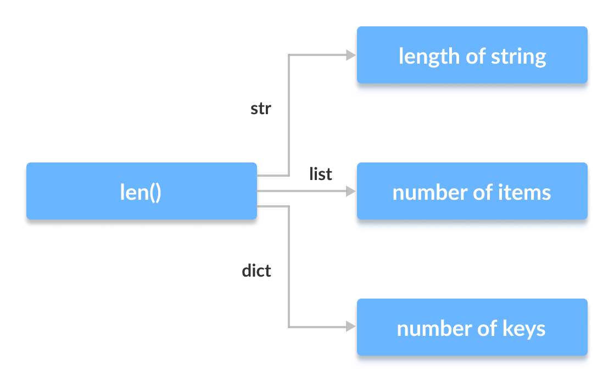

Slide 87
Polymorphism with Class Methods
We can use the concept of polymorphism while creating class methods as Python allows different classes to have methods with the same name.
We can then later generalize calling these methods by disregarding the object we are working with.
class Cat:
def __init__(self, name, age):
self.name = name
self.age = age
def info(self):
print(f"I am a cat. My name is {self.name}. I am {self.age} years old.")
def make_sound(self):
print("Meow")

Slide 88
class Dog:
def __init__(self, name, age):
self.name = name
self.age = age
def info(self):
print(f"I am a dog. My name is {self.name}. I am {self.age} years old.")
def make_sound(self):
print("Bark")
cat1 = Cat("Kitty", 2.5)
dog1 = Dog("Fluffy", 4)
for animal in (cat1, dog1):
animal.make_sound()
animal.info()
animal.make_sound()

Slide 89
Polymorphism and Inheritance
Like in other programming languages, the child classes in Python also inherit methods and attributes from the parent class. We can redefine certain methods and attributes specifically to fit the child class, which is known as Method Overriding.
Polymorphism allows us to access these overridden methods and attributes that have the same name as the parent class.

Slide 90
from math import pi
class Shape:
def __init__(self, name):
self.name = name
def area(self):
pass
def fact(self):
return "I am a two-dimensional shape."
def __str__(self):
return self.name

Slide 91
class Square(Shape):
def __init__(self, length):
super().__init__("Square")
self.length = length
def area(self):
return self.length**2
def fact(self):
return "Squares have each angle equal to 90 degrees."
class Circle(Shape):
def __init__(self, radius):
super().__init__("Circle")
self.radius = radius
def area(self):
return pi*self.radius**2

Slide 92
a = Square(4)
b = Circle(7)
print(b)
print(b.fact())
print(a.fact())
print(b.area())

Slide 93
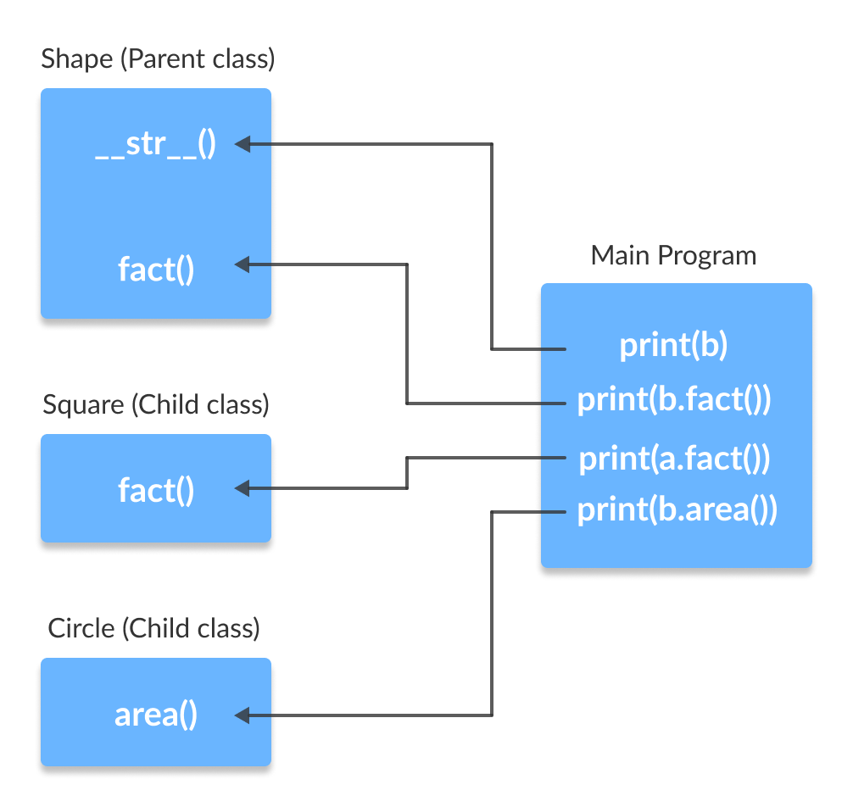

Slide 94
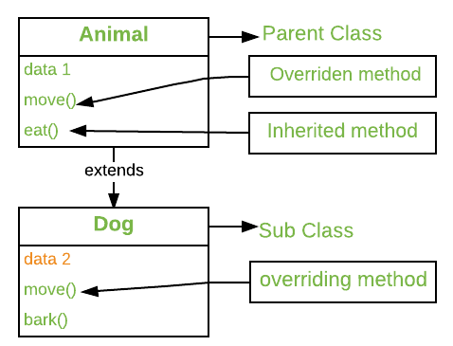

Slide 95
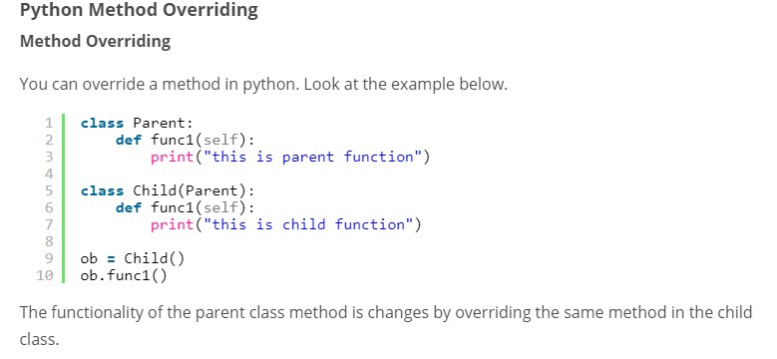

Slide 96
Calling the Parent’s method within the overridden method
Parent class methods can also be called within the overridden methods. This can generally be achieved by two ways.
1. Using Class name: Parent’s class methods can be called by using the Parent class name. method inside the overridden method.

Slide 97
class Parent():
def show(self):
print("Inside Parent")
class Child(Parent):
def show(self):
Parent.show(self)
print("Inside Child“)
obj = Child()
obj.show()

Slide 98
2. Using Super(): Python super() function provides us the facility to refer to the parent class explicitly. It is basically useful where we have to call superclass functions. It returns the proxy object that allows us to refer parent class by ‘super’.
class Parent():
def show(self):
print("Inside Parent")
class Child(Parent):
def show(self):
super().show()
print("Inside Child“)
obj = Child()
obj.show()

Slide 99
What is Overloading?
Overloading is the ability of a function or an operator to behave in different ways based on the parameters that are passed to the function, or the operands that the operator acts on.
Some of the advantages of using overload are:
Overloading a method fosters reusability. For example, instead of writing multiple methods that differ only slightly, we can write one method and overload it.
Overloading also improves code clarity and eliminates complexity.
Overloading is a very useful concept. However, it has a number of disadvantages associated with it.

Slide 100
Operator Overloading in Python
Operator overloading in Python is the ability of a single operator to perform more than one operation based on the class (type) of operands.
For example, the + operator can be used to add two numbers, concatenate two strings or merge two lists. This is possible because the + operator is overloaded with int and str classes.
Similarly, you can define additional methods for these operators to extend their functionality to various new classes and this process is called Operator overloading.

Slide 101
Operator Overloading in Python
Python Operator overloading enables us to use mathematical, logical and bitwise operators on python objects just like any primitive data type.

Slide 102
How To Overload Operators In Python?
In Python, when any operator is used, a special function is internally invoked by the compiler for that particular operator.
2-3 //sub(), +,-,*
Python methods that have double underscores before and after their names are called Magic methods or Special functions.
By changing this magic methods code, we can extend the functionality of the operator.
For example, when we use -= operator, the magic or special method __isub__ is invoked by the compiler.

Slide 103
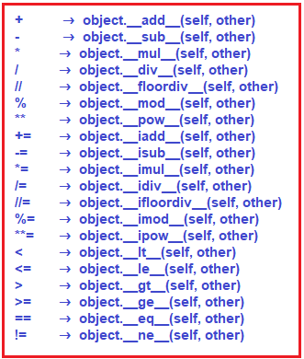
Python Magic Methods for Operator Overloading:

Slide 104
Function overloading
In Python, there are several functions that depict polymorphism by being compatible with multiple data types. The best example of this is the in-built len() function.
Example:-
print(len(“Hello World"))
print(len(["Python", "PHP", "C++"]))
print(len({"Name": "Rahul", "Address": "Kolkata,India"}))

Slide 105
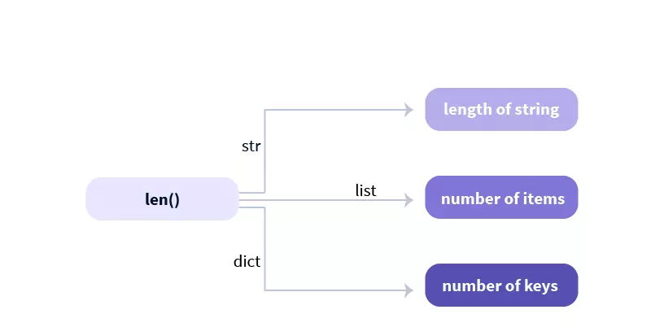
From the above code snippet, we can clearly understand the len() function worked for all three data types- strings, lists and dictionaries.

Slide 106
Method Overloading in Python
In Python, you can create a method that can be called in different ways.
So, you can have a method that has zero, one, or more parameters.
Depending on the method definition, we can call it with zero, one or more arguments.
Given a single method or function, the number of parameters can be specified by you.
This process of calling the same method in different ways is called method overloading.

Slide 107
Polymorphism with Function and Objects
You can create a function that can take any object, allowing for polymorphism.
We can create polymorphism with a function that can take any object as a parameter and execute its method without checking its class type.
Using this, we can call object actions using the same function instead of repeating method calls.

Slide 108
Let’s take an example and create a function called “func()”
which will take an object which we will name “obj”.
Now, let’s give the function something to do that uses the ‘obj’ object we passed to it.
In this case, let’s call the methods type() and color(), each of which is defined in the two classes ‘Tomato’ and ‘Apple’. Now, you have to create instantiations of both the ‘Tomato’ and ‘Apple’ classes if we don’t have them already:

Slide 109
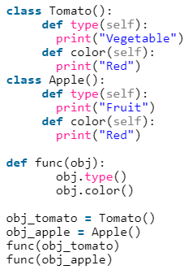

Slide 110
Encapsulation
Encapsulation is one of the critical features of object-oriented programming, which involves the bundling of data members and functions inside a single class.
Bundling similar data members and functions inside a class also helps in data hiding.
Encapsulation also ensures that objects are self-sufficient functioning pieces and can work independently.

Slide 111
Encapsulation
It describes the idea of wrapping data and the methods that work on data within one unit.
This puts restrictions on accessing variables and methods directly and can prevent the accidental modification of data.
To prevent accidental change, an object’s variable can only be changed by an object’s method. Those types of variables are known as private variable.
A class is an example of encapsulation as it encapsulates all
the data that is member functions, variables, etc.

Slide 112
The way that data and methods are organized does not matter to the end-user.
The user is only concerned about the right way to provide input and expects a correct output on the basis of the inputs provided.
Encapsulation in Python also ensures that objects are self-sufficient functioning pieces and can work independently
Encapsulation acts as a protective layer by ensuring that, access to wrapped data is not possible by any code defined outside the class in which the wrapped data are defined. Encapsulation provides security by hiding the data from the outside world.

Slide 113
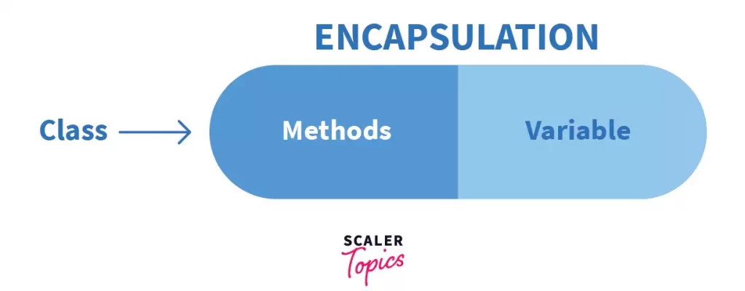

Slide 114
Consider a real-life example of encapsulation, in a company, there are different sections like the accounts section, finance section, sales section etc.
The finance section handles all the financial transactions and keeps records of all the data related to finance.
Similarly, the sales section handles all the sales-related
activities and keeps records of all the sales.
Now there may arise a situation when for some reason an official from the finance section needs all the data about sales in a particular month.

Slide 115
In this case, he is not allowed to directly access the data of the
sales section.
He will first have to contact some other officer in the sales section and then request him to give the particular data. This is what encapsulation is.
Here the data of the sales section and the employees that can manipulate them are wrapped under a single name “sales section”. Using encapsulation also hides the data. In this example, the data of the sections like sales, finance, or accounts are hidden from any other section.

Slide 116
Access Modifiers in Python encapsulation
Sometimes there might be a need to restrict or limit access to certain variables or functions while programming.
That is where access modifiers come into the picture.
Now when we are talking about access, 3 kinds of access specifiers can be used while performing Encapsulation in Python.
They are as follows :
Public Members
Private Members
Protected Members

Slide 117
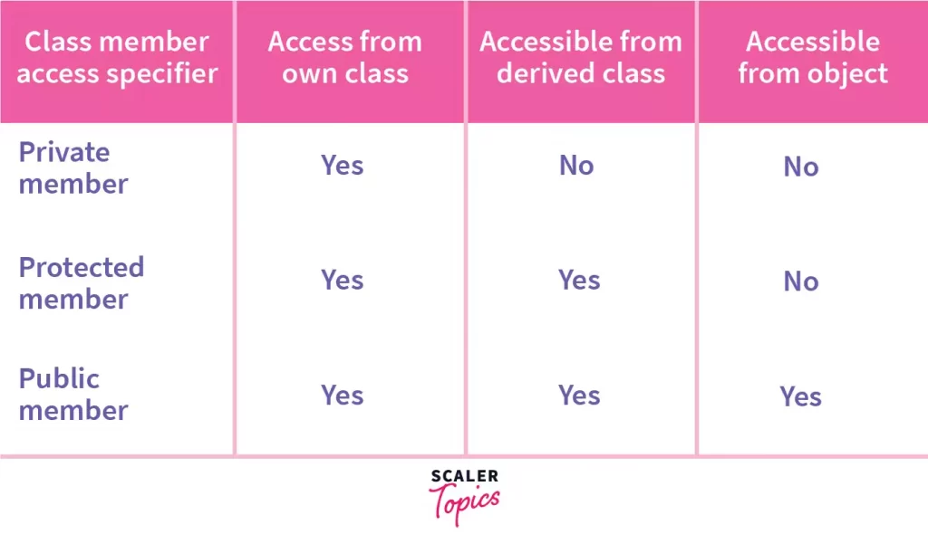

Slide 118
Encapsulation in Python using public members
As the name suggests, the public modifier allows variables and functions to be accessible from anywhere within the class and from any part of the program.
All member variables have the access modifier as public by default.

Slide 119
# illustrating public members & public access modifier
class pub_mod:
# constructor
def __init__(self, name, age):
self.name = name
self.age = age
def Age(self):
# accessing public data member
print("Age: ", self.age)
# creating object
obj = pub_mod(“abc", 35);
# accessing public data member
print("Name: ", obj.name)
# calling public member function of the class
obj.Age()

Slide 120
Encapsulation in Python using private members
The private access modifier allows member methods and variables to be accessed only within the class.
To specify a private access modifier for a member, we make use of the double underscore __.

Slide 121
# illustrating private members & private access modifier
class Rectangle:
__length = 0 #private variable
__breadth = 0#private variable
def __init__(self):
#constructor
self.__length = 5
self.__breadth = 3
#printing values of the private variable within the class
print(self.__length)
print(self.__breadth)
rect = Rectangle() #object created
#printing values of the private variable outside the class
print(rect.length)
print(rect.breadth)

Slide 122
Encapsulation in Python using protected members
What sets protected members apart from private members is that they allow the members to be accessed within the class and allow them to be accessed by the sub-classes involved.
In Python, we demonstrate a protected member by prefixing with an underscore _ before its name.
As we know, if the members have a protected access specifier, it can also be referenced then within the class and the subsequent sub-clas

Slide 123
# illustrating protected members & protected access modifier
class details:
_name="Jason"
_age=35
_job="Developer"
class pro_mod(details):
def __init__(self):
print(self._name)
print(self._age)
print(self._job)
# creating object of the class
obj = pro_mod()
# direct access of protected member
print("Name:",obj.name)
print("Age:",obj.age)

Slide 124
Getters and setters
In object oriented programming, methods which are dedicated to accessing and changing attributes are usually called getters and setters.
Not all Python programmers use the terms "getter" and "setter", but the concept of properties outlined below is very similar, which is why we will use the generally accepted object oriented programming terminology here.

Slide 125
these methods allow you to access and mutate private attributes while maintaining encapsulation.
In Python, you’ll typically expose attributes as part of your public API and use properties when you need attributes with functional behaviour.
When you define a class in object-oriented programming (OOP), you’ll likely end up with some instance and class attributes. These attributes are just variables that you can access through the instance, the class, or both.
Attributes hold the internal state of objects. In many cases, you’ll need to access and mutate this state, which involves accessing and mutating the attributes.
Typically, you’ll have at least two ways to access and mutate attributes.

Slide 126
Access and mutate the attribute directly
Use methods to access and mutate the attribute
In Python, getters and setters are not the same as those in other object-oriented programming languages. Basically, the main purpose of using getters and setters in object-oriented programs is to ensure data encapsulation.
Private variables in python are not actually hidden fields like in other object oriented languages.
Getters and Setters in python are often used when:
We use getters & setters to add validation logic around getting and setting a value.
To avoid direct access of a class field i.e. private variables cannot be accessed directly or modified by external user.

Slide 127
Getter: A method that allows you to access an attribute in a given class
Setter: A method that allows you to set or mutate the value of an attribute in a class
In Python property() is a built-in function that creates and returns a property object.
A property object has three methods, getter(), setter(), and delete().
property() function in Python has four arguments property(fget, fset, fdel, doc), fget is a function for retrieving an attribute value. fset is a function for setting an attribute value. fdel is a function for deleting an attribute value. doc creates a docstring for attribute.

Slide 128
A property object has three methods, getter(), setter(), and delete() to specify fget, fset and fdel individually.

Slide 129
class Wallet:
def __init__(self):
self.__money = 0
# A getter method
@property
def money(self):
return self.__money
# A setter method
@money.setter
def money(self, money):
if money >= 0:
self.__money = money

Slide 130
wallet = Wallet()
print(wallet.money)
wallet.money = 50
print(wallet.money)
wallet.money = -30
print(wallet.money)

Slide 131
Abstraction
The process by which data and functions are defined in such a way that only essential details can be seen and unnecessary implementations are hidden is called Data Abstraction.
The main focus of data abstraction is to separate the interface and the implementation of the program.
Abstraction is really powerful for making complex tasks and codes simpler when used in Object-Oriented Programming.
It reduces the complexity for the user by making the relevant part accessible and usable leaving the unnecessary code hidden.
Also, there are times when we do not want to give out sensitive parts of our code implementation and this is where data abstraction can also prove to be very functional.

Slide 132
Abstract classes
Data Abstraction in Python can be achieved through creating abstract classes and inheriting them later.
An abstract class can be considered as a blueprint for other classes.
The classes that cannot be instantiated. This means that we cannot create objects of an abstract class and these are only meant to be inherited.
Then an object of the derived class is used to access the features of the base class.
These are specifically defined to lay a foundation of other classes that exhibit common behaviour or characteristics.

Slide 133
The abstract class is an interface. Interfaces in OOP enable a class to inherit data and functions from a base class by extending it.
It allows you to create a set of methods that must be created within any child classes built from the abstract class.
A class which contains one or more abstract methods is called an abstract class.
An abstract method is a method that has a declaration but does not have an implementation.

Slide 134
While we are designing large functional units we use an abstract class.
When we want to provide a common interface for different implementations of a component, we use an abstract class.
an abstract class just serves as a template for other classes by defining a list of methods that the classes must implement.
To use such a class, we must derive them keeping in mind that we would either be using or overriding the features specified in that class.

Slide 135
Consider an example where we create an abstract class Fruit.
We derive two classes Mango and Orange from the Fruit class that implement the methods defined in this class.
Here the Fruit class is the parent abstract class and the classes Mango and Apple become the sub/child classes.
We won’t be able to access the methods of the Fruit class by simply creating an object, we will have to create the objects of the derived classes: Mango and Apple to access the methods.

Slide 136
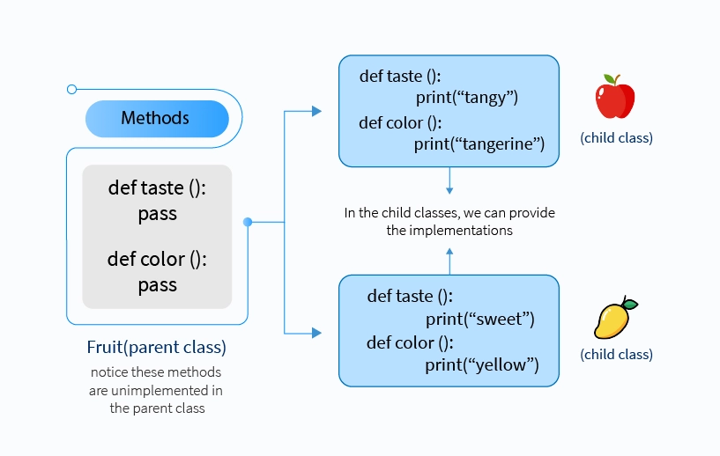

Slide 137
Why Use Abstract Classes
By defining an abstract base class, you can define a common
Application Program Interface(API) for a set of subclasses.
This capability is especially useful in situations where a third- party is going to provide implementations, such as with plugins, but can also help you when working in a large team or with a large code-base where keeping all classes in your mind is difficult or not possible.

Slide 138
How Abstract Classes works
By default, Python does not provide abstract classes.
Python comes with a module that provides the base for defining Abstract Base classes(ABC) and that module name is ABC.
Syntax for creatin Abstract class
from abc import ABC
class MyABC(ABC):
pass
ABC works by decorating methods of the base class as abstract and then registering concrete classes as implementations of the abstract base.
A method becomes abstract when decorated with the keyword @abstractmethod. For Example

Slide 139
There are two types of methods in abstract class
Abstract Methods
Concrete Method
ABC is defined in a way that the abstract methods in the base class are created by decorating with the @abstractmethod keyword and the concrete methods are registered as implementations of the base class.

Slide 140
Concrete Methods in Abstract Base Class in Python
We now know that we use abstract classes as a template for other similarly characterized classes.
Using this, we can define a structure, but do not need to provide complete implementation for every method, such as:
from abc import ABC, abstractmethod
class MyClass(ABC):
@abstractmethod
def mymethod(self):
#empty body
pass

Slide 141
The methods where the implementation may vary for any other subclass are defined as abstract methods and need to be given an implementation in the subclass definition.
On the other hand, there are methods that have the same implementation for all subclasses as well.
There are characteristics that exhibit the properties of the abstract class and so, must be implemented in the abstract class itself.
Otherwise, it will lead to repetitive code in all the inherited classes. These methods are called concrete methods.

Slide 142
from abc import ABC, abstractmethod
class Parent(ABC):
#common function
def common_fn(self):
print('In the common method of Parent')
@abstractmethod
def abs_fn(self):
#is supposed to have different implementation in child classes
pass
class Child1(Parent):
def abs_fn(self):
print('In the abstract method of Child1')
class Child2(Parent):
def abs_fn(self):
print('In the abstract method of Child2')

Slide 143
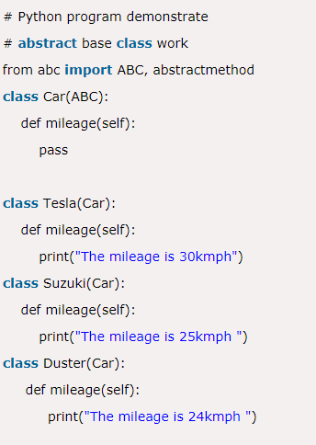

Slide 144
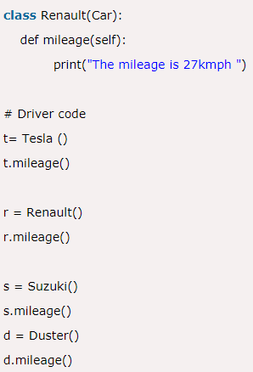

Slide 145
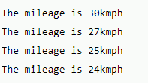

Slide 146
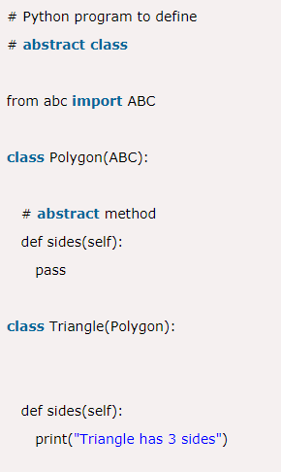

Slide 147
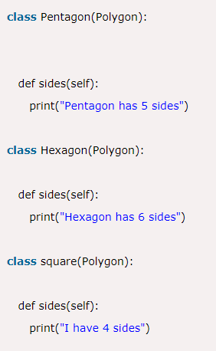

Slide 148
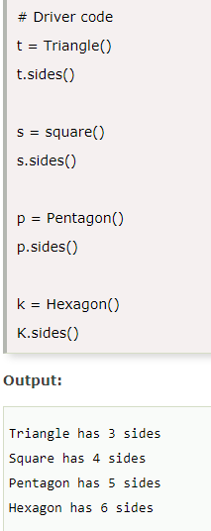

Slide 149
An abstract class can have both abstract methods and concrete methods.
We can now access the concrete method of the abstract class by instantiating an object of the child class. We can also access the abstract methods of the child classes with it. Interesting points to keep in mind are:
We always need to provide an implementation of the abstract method in the child class even when implementation is given in the abstract class.
A subclass must implement all abstract methods that are defined in the parent class otherwise it results in an error.

Slide 150
from abc import ABC, abstractmethod
class Animal(ABC):
#concrete method
def sleep(self):
print("I am going to sleep in a while")
@abstractmethod
def sound(self):
print("This function is for defining the sound by any animal")
pass

Slide 151
class Snake(Animal):
def sound(self):
print("I can hiss")
class Dog(Animal):
def sound(self):
print("I can bark")
class Lion(Animal):
def sound(self):
print("I can roar")
class Cat(Animal):
def sound(self):
print("I can meow")

Slide 152
Abstract Class Instantiation
Abstract classes are incomplete because they have methods that have nobody.
If python allows creating an object for abstract classes then using that object if anyone calls the abstract method, but there is no actual implementation to invoke.
So we use an abstract class as a template and according to the need, we extend it and build on it before we can use it.
Due to the fact, an abstract class is not a concrete class, it cannot be instantiated.
When we create an object for the abstract class it raises an error.

Slide 153
Dynamic Binding:
In dynamic binding, the code to be executed in response to
the function call is decided at runtime.
Dynamic binding means that the code associated with a given procedure call is not known until the time of the call at run time.
Dynamic Method Binding One of the main advantages of inheritance is that some derived class D has all the members of its base class B. Once D is not hiding any of the public members of B, then an object of D can represent B in any context where a B could be used. This feature is known as subtype polymorphism.

Slide 154
Message Passing:
It is a form of communication used in object-oriented
programming as well as parallel programming.
Objects communicate with one another by sending and receiving information to each other.
A message for an object is a request for execution of a procedure and therefore will invoke a function in the receiving object that generates the desired results.
Message passing involves specifying the name of the object, the name of the function, and the information to be sent.

Slide 155
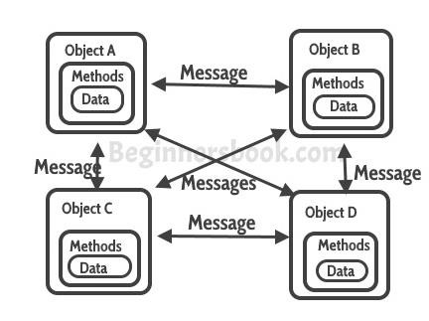

Slide 156
Here the “state” of the cat is the private variables mood, hungry and energy. It also has a private method meow(). It can call it whenever it wants, the other classes can’t tell the cat when to meow.
What they can do is defined in the public methods sleep(), play() and feed(). Each of them modifies the internal state somehow and may invoke meow(). Thus, the binding between the private state and public methods is made.
This is encapsulation.

